Slide 1
Lighthorne Heath Early Years
Our Early Years Prospectus

Slide 2
Welcome to Lighthorne Heath Nursery
“Where Every Child Matters”
Our Nursery
Aims
Starting Nursery
What Will the Children Do
Clothing & Session times
6 Food & Dietary Needs
7 Child Protection/Health & Safety
8 Working in Partnership
9 Staff

Slide 3
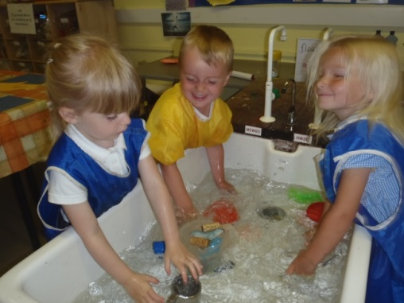
Our Nursery
Lighthorne Heath Nursery is part of Lighthorne Heath Primary School . The children work and play alongside Reception 1 at the school in a large classroom with lots of practical areas. There is a fantastic outdoor classroom too which is fenced off for security and includes wooden play equipment, a sand pit and a story telling and performance area.
The school caters for children from age 3 to 11 and there are 3 classes. In November 2010 we federated with a school in Leamington called Sydenham Primary School and the Executive Head Teacher now works across both schools.
We are a small and very friendly school where everyone is valued and we hope to provide your child with an exciting, inspiring range of learning opportunities in a safe and caring environment.
If you have any questions or concerns
please do not hesitate to ask any of the staff.
1

Slide 4
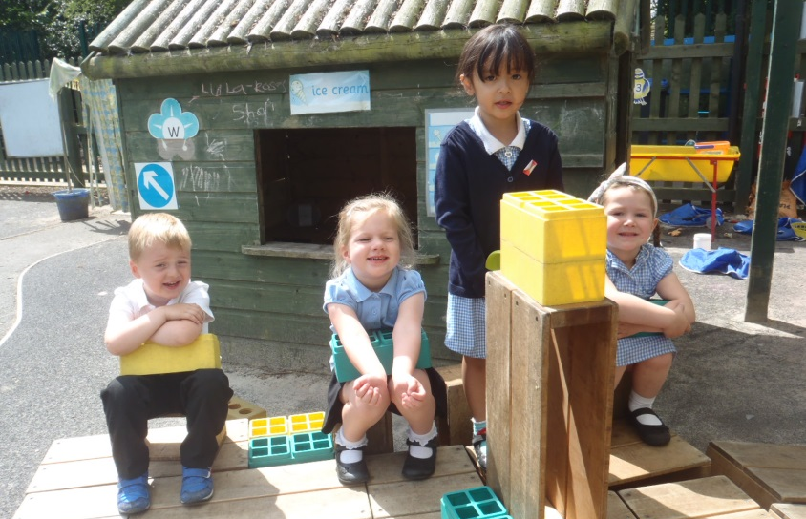
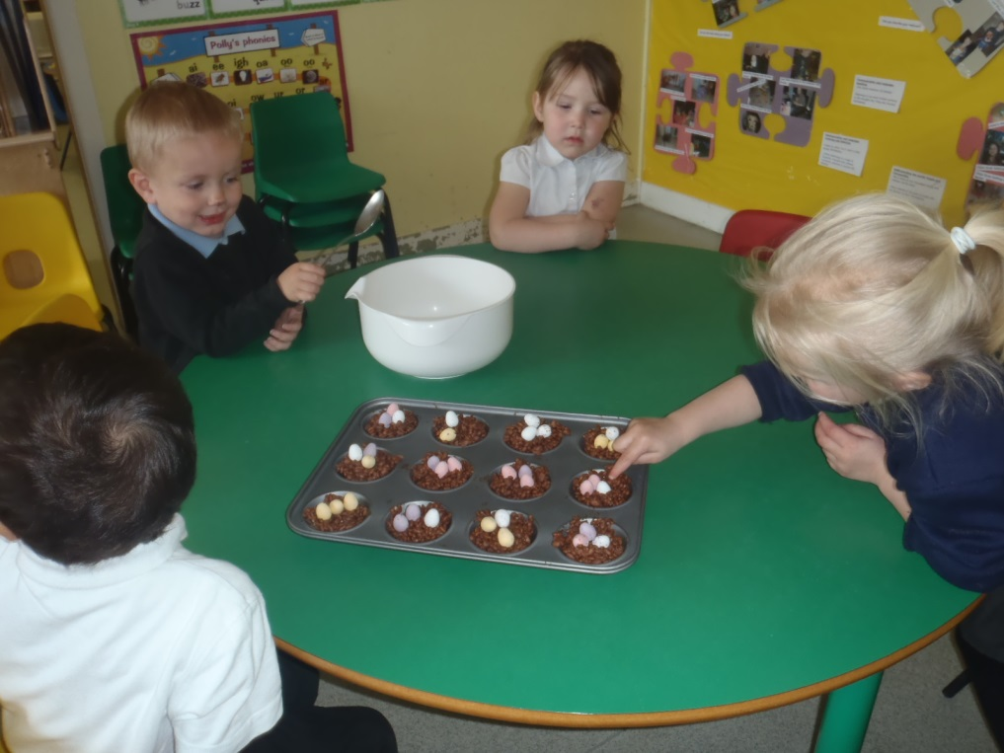
Aims
Our aim is to provide:
a safe, caring, creative and stimulating environment,
in which all children
are encouraged to achieve their full potential, academically, physically, emotionally, morally, creatively and socially.
We encourage them to
develop a positive attitude to learning through a wide range of exciting, hands on learning opportunities.
2

Slide 5
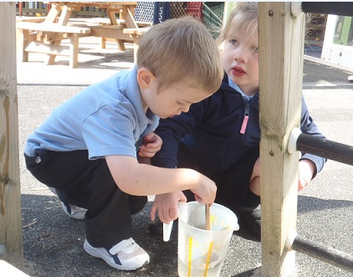
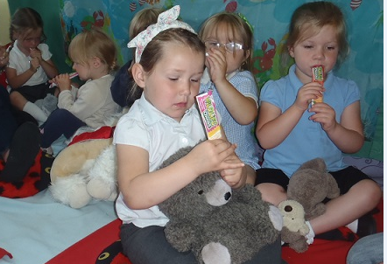
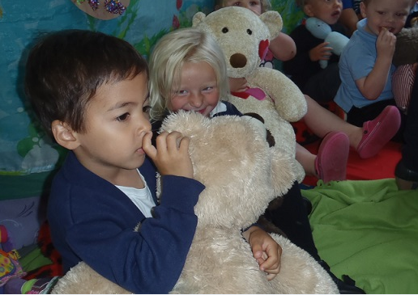
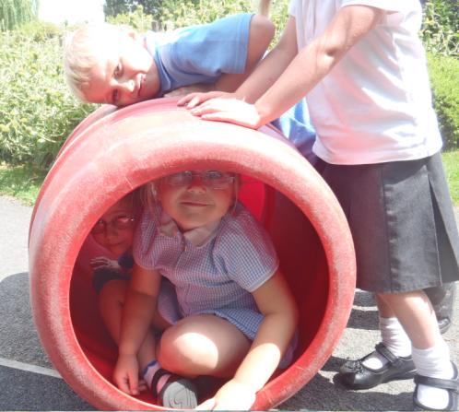
Starting Nursery
Children can start nursery in the term after their third birthday. We will offer you some induction sessions which will help you and your child get to know our staff and feel more settled when they start properly.
Your child will be invited to a ‘Stay and Play’ session. You will also be offered the opportunity to have a home visit so that staff can meet your child in a more informal environment and answer any questions you might have.
We will do our best to ensure your child settles into nursery quickly and happily
3

Slide 6
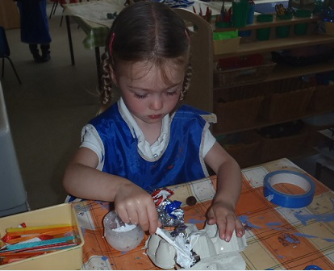
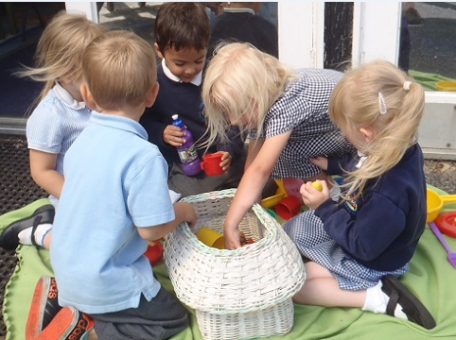
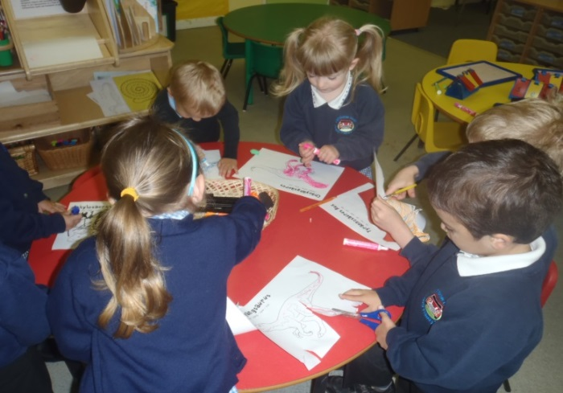
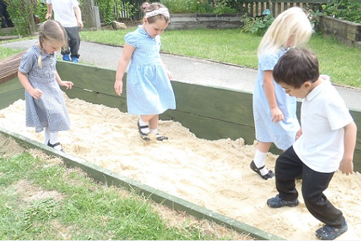
What will the children do
In Nursery the children are part of the Early Years Foundation Stage which continues until the end of their Reception Year. They follow the Foundation Stage Curriculum which is organised into seven areas of learning:
Personal, social and emotional development
Physical development
Communication and language
Literacy
Mathematics
Understanding the world
Expressive arts and design
Everything in Nursery is carefully planned and structured to support your child’s individual development. During the year all of the children are assessed in all of these areas of learning. Through these observations, staff plan for children’s learning, enabling them to build upon previous experiences. Children’s progress is recorded through photographs and comments about their learning in a special book.
4

Slide 7
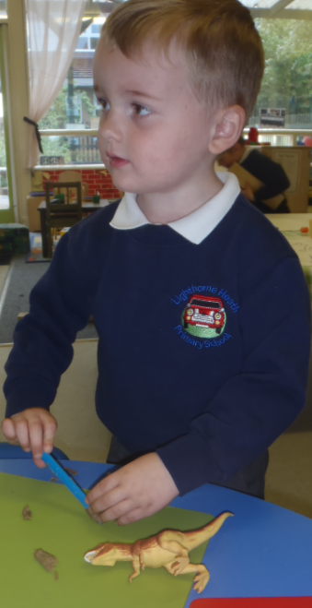
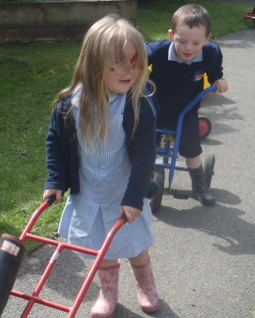
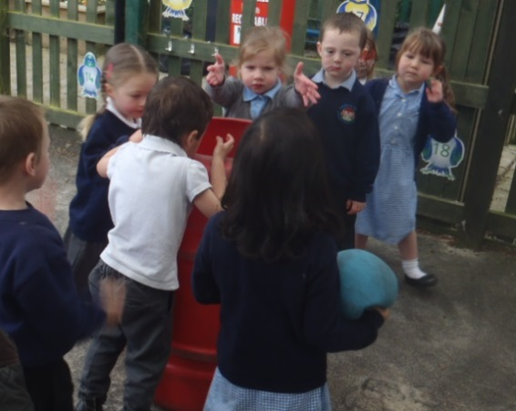
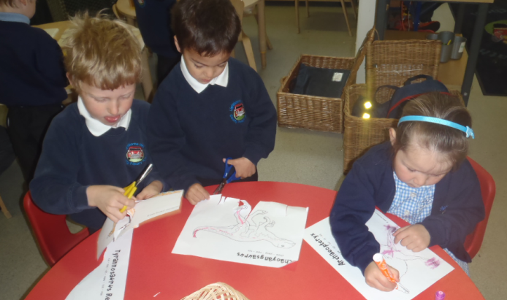
Clothing & Session Times
Times
8.55am ~12.00pm
Parents and carers can accompany their children into nursery in the morning to greet their key workers and settle them in. Please ensure that you arrive on time since, not only is this an important habit for your children to learn, but it also helps children to settle more quickly into their learning and routines.
Children should be collected at 12 noon from the classroom via the door at the back of the nursery.
If you have arranged for someone different to pick your child up on any particular day, please let the nursery staff know.
Children need to be suitably dressed to join in with messy, practical activities indoors and out. They should wear appropriate footwear.
The school uniform is not compulsory, however most parents opt to put their children in it. If you do choose for your child to wear uniform, it consists of a white or blue polo shirt and grey or black trousers or skirts. Children can wear a blue, black or grey cardigan or sweatshirt to keep them warm. Sweatshirts, cardigans and fleeces with the school logo on are available from the office. In the summer children may wear blue and white check summer dresses or shorts. Caps with the school logo on are available from the office too.
It is important that all of the children’s clothes are named.
Sometimes children have accidents while they are at nursery so
it is really helpful if you are able to provide a spare set of named clothes to keep in a bag on their peg just in case! For safety reasons, children are not allowed to wear jewellery.
5

Slide 8
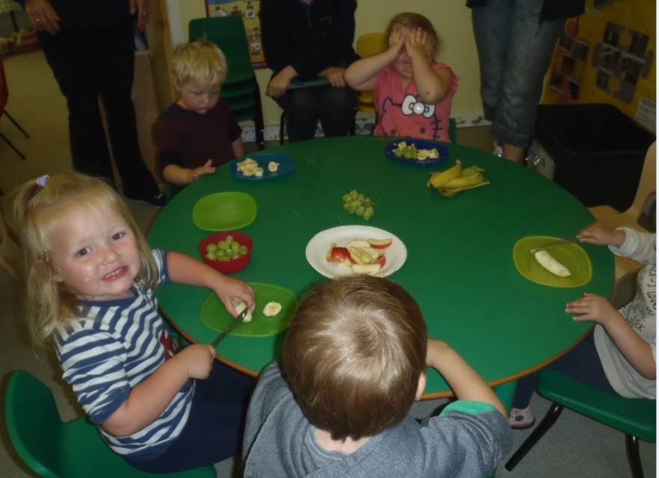
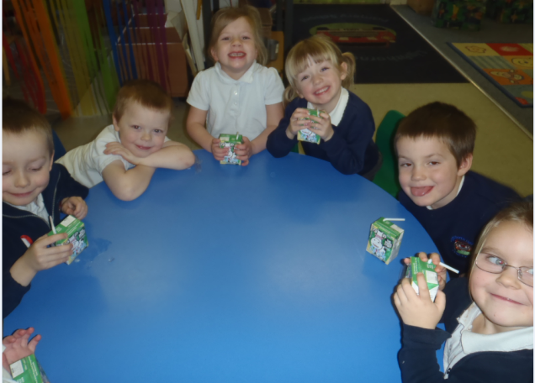
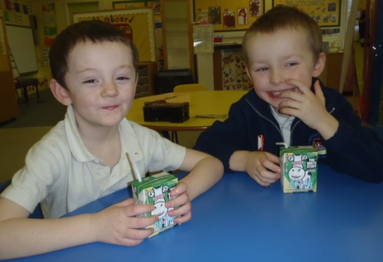
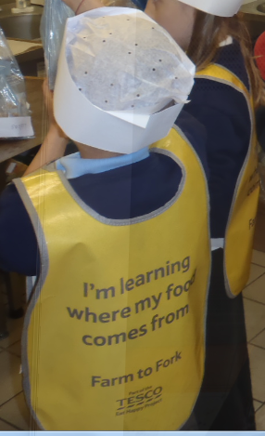
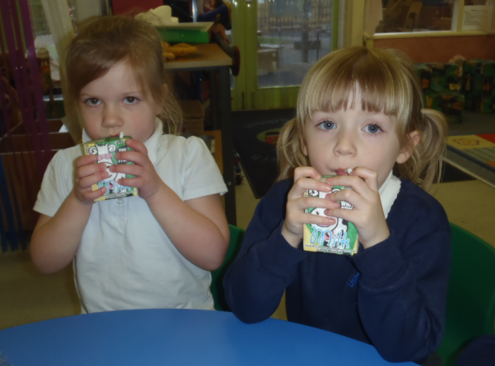
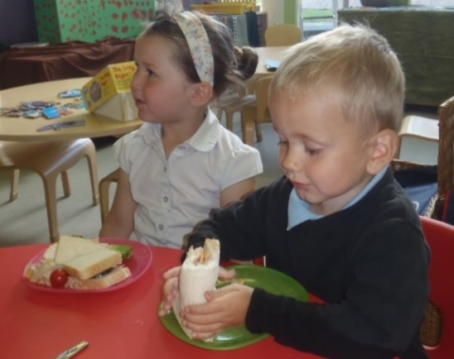
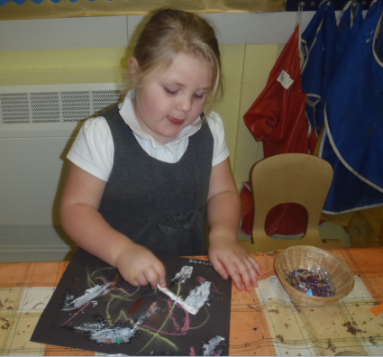
Food & Dietary Needs
We promote healthy eating wherever possible at
Lighthorne Heath. Children are all provided with milk and fruit during the morning to keep them full of energy!
Water is always available to the children throughout the day and if children would like to bring in a plastic water bottle this can be re-filled. The bottles should contain water, not squash and please remember to name the bottles.
Costs of Our Nursery
Our Nursery education is free. However, from time to time you may be asked to make a contribution towards visits or other activities.
6

Slide 9
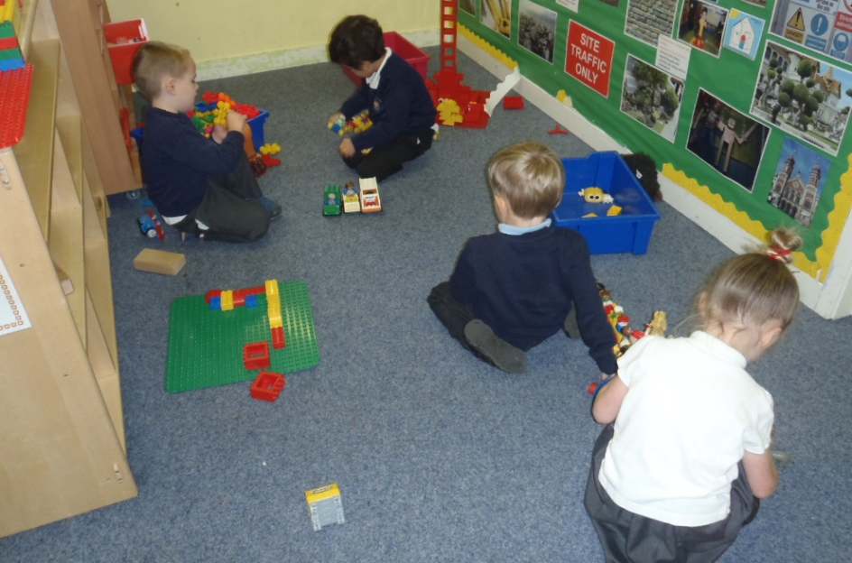
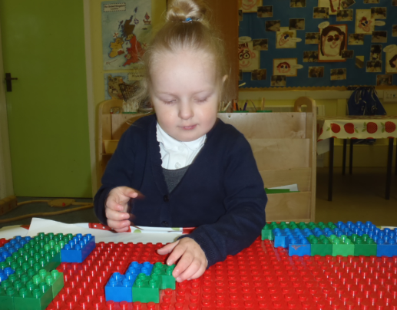
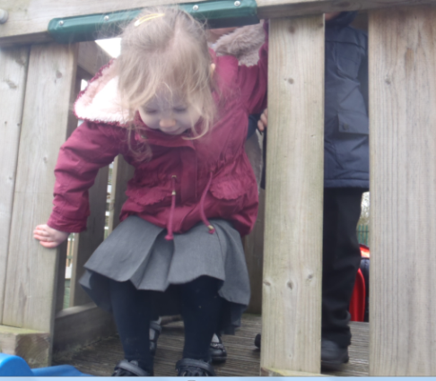
Child Protection, Health & Safety
Health and Safety
The safety and welfare of your child is of paramount importance to us at Lighthorne Heath and we make every effort to ensure that the Nursery is a safe and happy place to be at all times.
If children have an accident in school we have 2 trained first aiders to treat them. All injuries are recorded in our accident book and the child is given a slip to take home too.
To help us with this we ask for your cooperation with the following matters:
Ensure the office have up-to-date contact details in case we need to get in touch with you
Let staff know if someone different will be collecting your child
Inform staff of any allergies or medication your child is taking (e.g. Inhalers)
Always use the correct doors and make sure they are shut behind you
If your child is poorly or unable to attend nursery for any reason, please call the office to let us know
If your child is poorly with sickness or diarrhoea, they should not return to Nursery for 48 hours
Let your key worker know if your child has had an accident at home
1
Safeguarding
The school and nursery have a Child Protection Policy and there are procedures in place for staff to follow in any situation concerned with the safety of children. Safety is discussed with the children regularly.
7

Slide 10
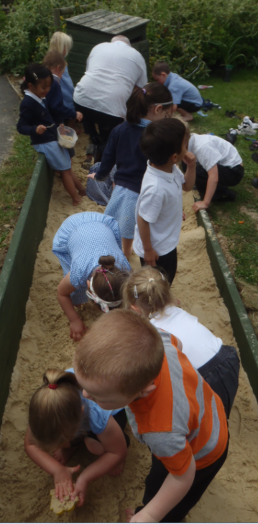
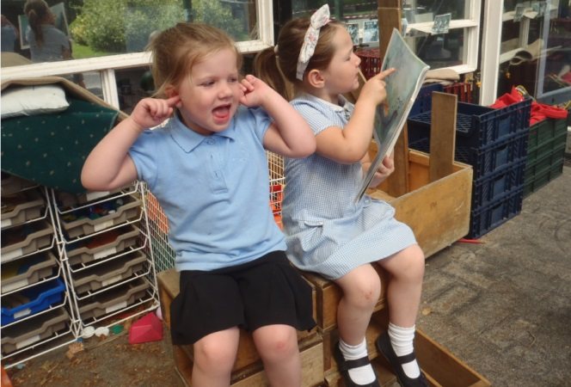
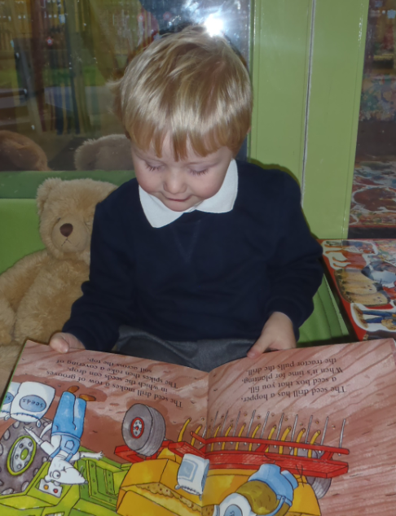
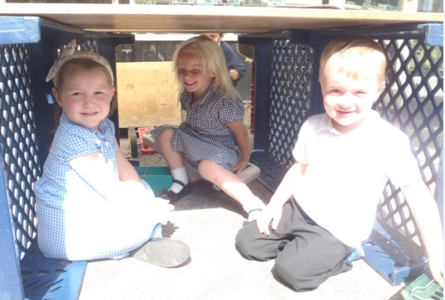
Working in Partnership
The school works in close partnership with Lighthorne Heath Children’s Centre. The Children’s Centre offers a range of services for the parents, carers and families of children aged under five living in the area including a Nurture Nursery for 2-year olds. Other activities for the whole community are offered, such as Stay and Play, coffee mornings, adult learning and counselling services, as well as advice about benefits, tax credits and employment opportunities. In addition, parents are able to get antenatal and parenting support, and advice about their child’s well being.
Significant other partnerships include: Warwick Volunteers at the University of Warwick; Warwick University’s Institute of Education; and very good links with local secondary schools and colleges, South Warwickshire NHS Integrated and Community Care Division and Schools Nursing Service, Speech and Language Therapy Department, RNLI Lifeguards, The Heritage Motor Centre, Jaguar Land Rover, Onside Coaching Ltd, Artists in Residence, Positive About Young People and Warwickshire Integrated Disability Service
8

Slide 11
